Slide 1
Case Study : Clustering of Countries based on Covid19 Vaccination
Priyaranjan Mishra
March 20, 2023

Slide 2
Content
Agenda
Assumptions
Matrices Used
Clustering Methodology
Visualizations
Conclusion

Slide 3
Agenda
Clustering of countries based on country specific economic parameters imperative to the healthcare framework based on the world bank & WHO data for a Vaccine Product.
Source: Our World in data. URL: http://surl.li/fpxak

Slide 4
Content
Agenda
Assumptions
Matrices Used
Clustering Methodology
Visualizations
Conclusion

Slide 5
Assumptions used in the model
We are considering only those countries that have reported more than 10,000 cases
Country’s vaccination details must be available as per the WHO website
Imputations done on the data:
For Bulgaria: Imputed people vaccinated as half of total vaccinated people
Extreme Poverty data was imputed based on desk research
Source: Our World in data. URL: http://surl.li/fpxak

Slide 6
Content
Agenda
Assumptions
Matrices Used
Clustering Methodology
Visualizations
Conclusion

Slide 7
Variables used in the data | Meta Data
Location : Name of the country
total_cases_per_million : No. of cases per million population of the country
new_cases_per_million : No. of new cases per million population
total_deaths_per_million : Total deaths per million population
new_deaths_per_million : New Deaths per million population
total_vaccinations_per_hundred : Vaccinations carried out per hundred population
people_vaccinated_per_hundred : Total people injected with atleast one dose of vaccination
people_fully_vaccinated_per_hundred : People fully vaccinated
total_boosters_per_hundred : People that have taken the booster dose as well
population_density : Population per unit area
median_age :Age that divides the population is two equal size
aged_65_older : People Aged More than 65 years
gdp_per_capita : Economic output of a nation per persion
extreme_poverty : Percentage of people living on less than $2.15 a day
diabetes_prevalence : How prevalent is diabetes
female_smokers : Percentage or female that smokers
male_smokers : Percentage of male smokers
hospital_beds_per_thousand : no. of hospital beds per thousand population
life_expectancy : Average time a person is expected to live in a particular country
human_development_index: Summary measure of average achievement in a key dimensions of human development
Population : No. of people living in the country
Source: Our World in data. URL: http://surl.li/fpxak

Slide 8
Content
Agenda
Assumptions
Matrices Used
Clustering Methodology
Visualizations
Conclusion

Slide 9
Clustering Methodology
Data has been gathered from Our world in data website for covid19 vaccination and other economic parameters specific to countries
We are data as of January 31 2023 for our analysis
There were high correlation seen between a few variables, and we have used principal component analysis to solve this issue
There were quite a few outlier in our data but we had to keep in mind that we were identifying backward countries where our product could be marketed well. We had capped the data accordingly
Data has been scaled using Standard Scaler
Hierarchical Clustering (Nearest Neighbors) & PCA have been used to cluster the columns
Source: Our World in data. URL: http://surl.li/fpxak

Slide 10
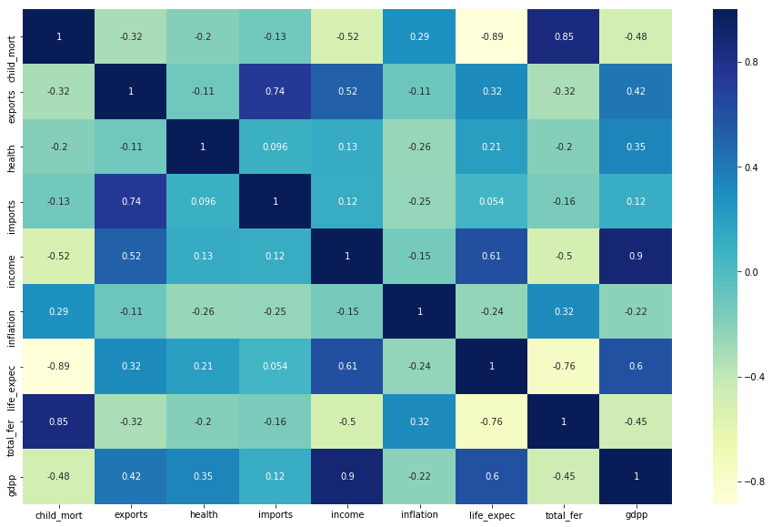
Correlation Plot
We can see there are high correlation between few variables and hence we have used PCA to address this issue
Source: Our World in data. URL: http://surl.li/fpxak

Slide 11
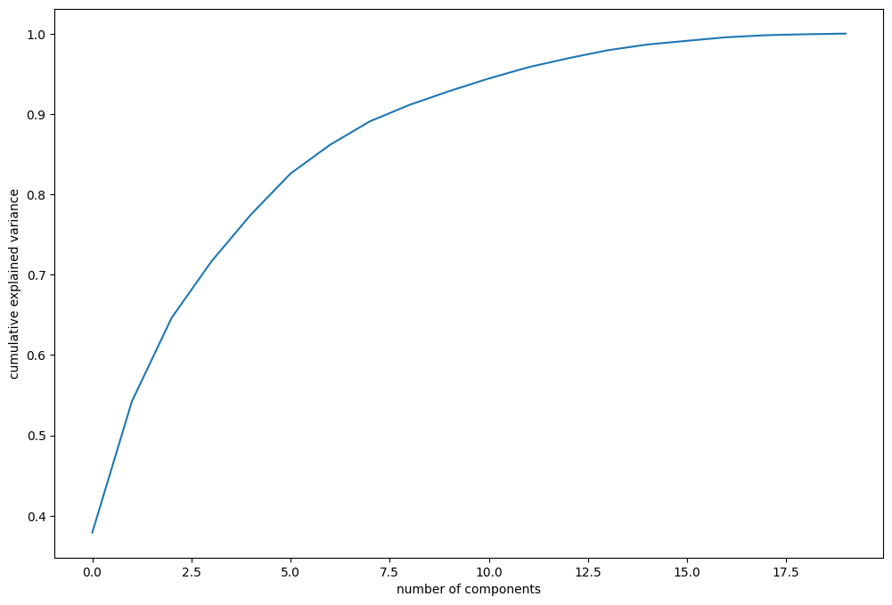
The screen-plot suggests that 8 components are enough to explain 90% variance in the dataset
Plot between cumulative explained variance and number of components to find the number of components required to create our model
Source: Our World in data. URL: http://surl.li/fpxak

Slide 12
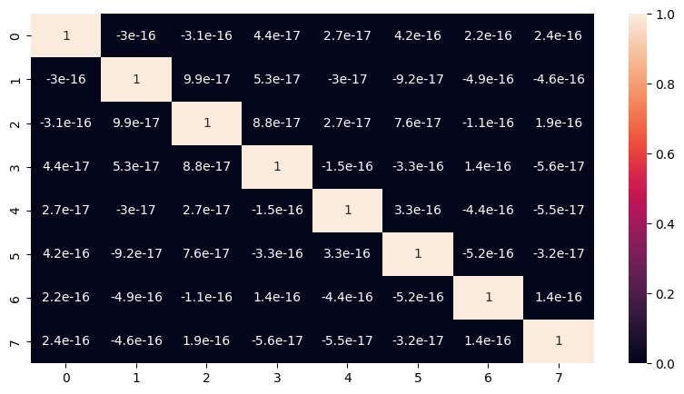
Correlation matrix for principal components
Suggests that there are little or no correlation among the principal components
Source: Our World in data. URL: http://surl.li/fpxak

Slide 13
Hopkin’s Statistics
The value of Hopkin’s Statistic was 70% which showed that the tendency of a data to cluster was high
Rules for Hopkin’s Statistics:
If the value is between {0.01, ...,0.3}, the data is regularly spaced.
If the value is around 0.5, it is random.
If the value is between {0.7, ..., 0.99}, it has a high tendency to cluster.
Source: Our World in data. URL: http://surl.li/fpxak

Slide 14
Content
Agenda
Assumptions
Matrices Used
Clustering Methodology
Visualizations
Conclusion

Slide 15
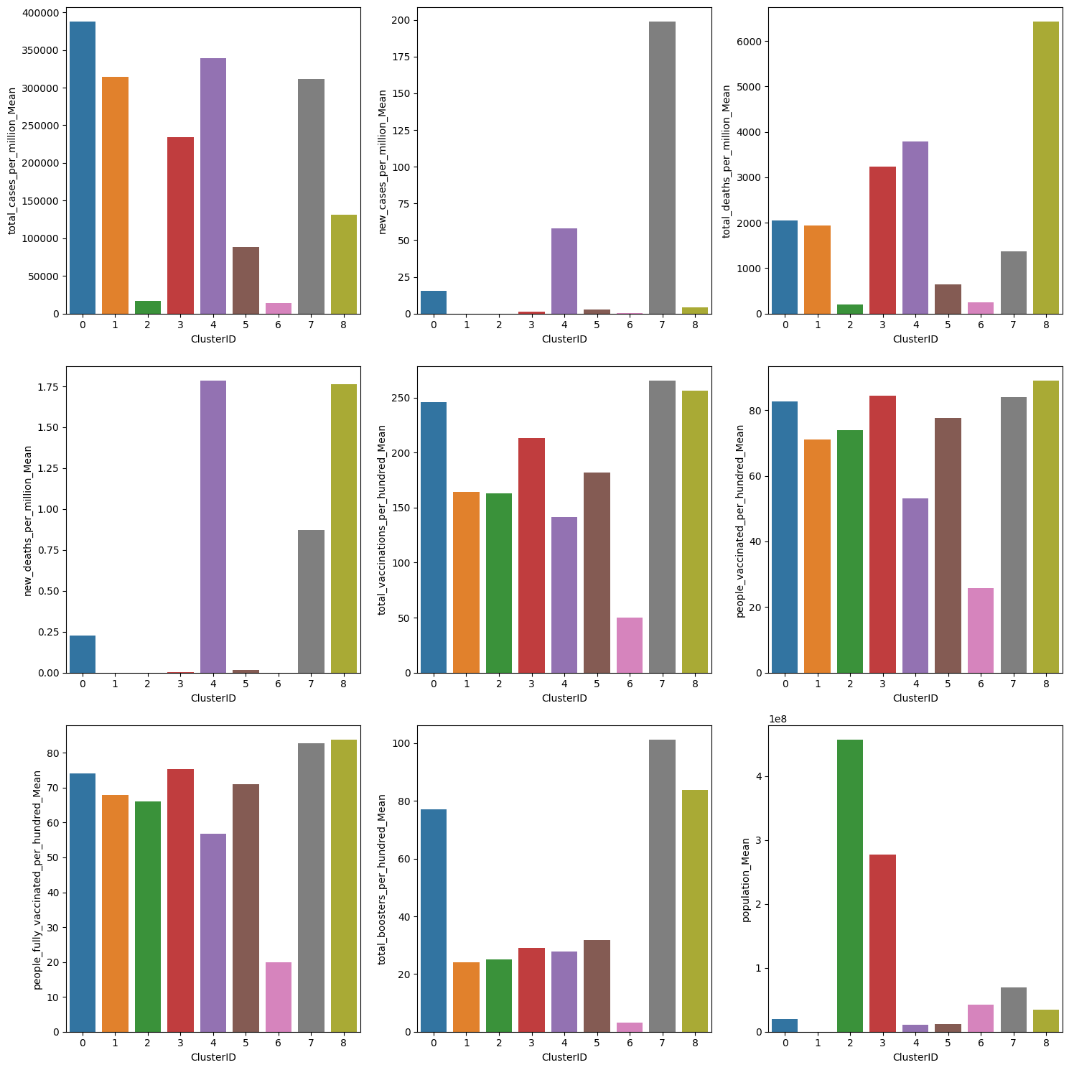
Clustering visualizations
Based on the 8 clusters created, cluster 4 was chosen to be the most important cluster if we are planning to launch our product in the respective countries underneath it

Slide 16
Additional Matrices used in clustering

Slide 17
Additional Matrices used in clustering

Slide 18
Content
Agenda
Assumptions
Matrices Used
Clustering Methodology
Visualizations
Conclusion

Slide 19
Countries with cluster ID 4 are the most important countries if we are promoting a new vaccination for covid19
Bulgaria
Croatia
Czechia
Estonia
Lithuania
Poland
High number of new cases
High total death per million population
Low number of people vaccinated
High old age people
Less people below poverty line
Good per capita GDP
Human development index is good
Source: Our World in data. URL: http://surl.li/fpxak

Slide 20
Thank you!
Questions?

